Slide 1
Basic Input / Output in C++
FILE Handling in C++
Souhad M. Daraghma

Slide 2
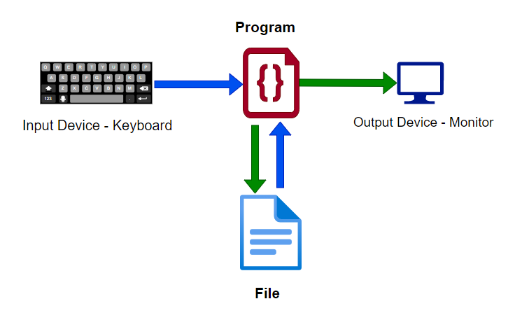
Overview
C++ comes with libraries that provide us with many ways for performing input and output.
In C++ input and output are performed in the form of a sequence of bytes or more commonly known as streams.
Input Stream: If the direction of flow of bytes is from the device(for example, Keyboard) to the main memory then this process is called input.
Output Stream: If the direction of flow of bytes is opposite, i.e. from main memory to device( display screen ) then this process is called output.

Slide 3
Header files available in C++ for Input/Output operations are:
iostream: iostream stands for standard input-output stream. This header file contains definitions of objects like cin, cout, cerr, etc.
iomanip: iomanip stands for input-output manipulators. The methods declared in these files are used for manipulating streams. This file contains definitions of setw, setprecision, etc.
fstream: This header file mainly describes the file stream. This header file is used to handle the data being read from a file as input or data being written into the file as output.

Slide 4
iostream - cin statement
The cin stement is used to enter data from the key board into main memory
Any program containing a cin or a cout must have the line
#include <iostream>
using namespace std;
The general form
cin>>var₁>>var₂>> … >>var_{n};
The variables var₁ , var₂, … ,var_{n} must be declared before the cin statement

Slide 5
iostream - cout statement
Used to output data to the screen
Has the form
cout<<arg₁<<arg₂<< … <<arg_{n};
Each of arg₁,arg₂, … ,arg_{n} can be
a constant value (e.g. -3, 6.45, ‘A’, “ali”)
a variable
an expression

Slide 6
iostream - getline (char*) in C++
The C++ getline() is a standard library function that is used to read a string or a line from an input stream.
istream& getline(char* str, std::streamsize _Count);
Example:
char* y_name=new char[100];
cout << "Enter your name: ";
cin.getline (y_name, 100);

Slide 7
iostream - getline (string) in C++
istream& getline (istream& is, string& str);
istream& getline(istream& is, string& str, char delim);
#include <iostream>
#include <string>
using namespace std;
int main() {
string str;
cout << "Please enter your name: \n";
getline(cin, str);
cout << "Hello, " << str << " welcome to our class !\n";
return 0;
}

Slide 8
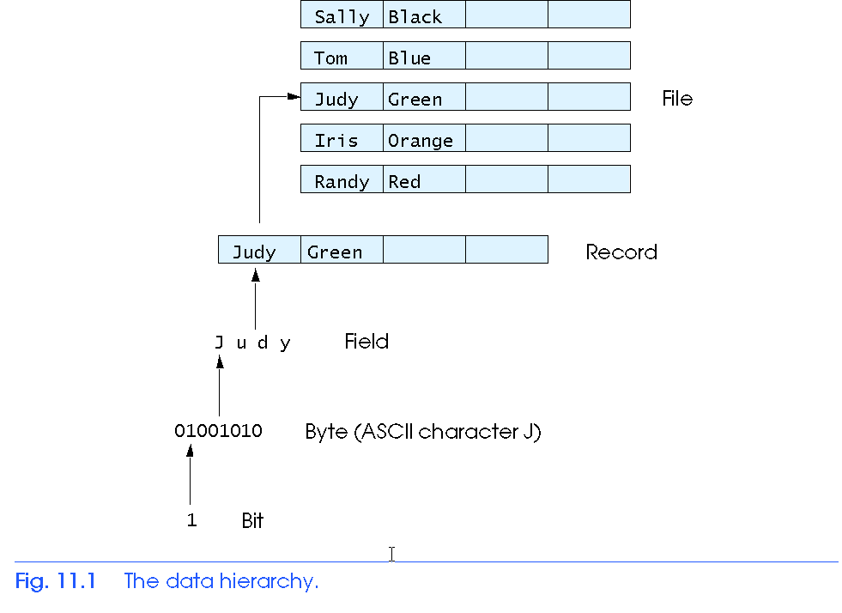
The Data Hierarchy
Bit – smallest data item
Value of 0 or 1
Byte – 8 bits
Used to store a character
Decimal digits, letters, and special symbols
Field – group of characters conveying meaning
Example: your name
Record – group of related fields
Represented by a struct or a class
Example: In a payroll system, a record for a particular employee that contained his/her identification number, name, address, etc.
File – group of related records
Example: payroll file
Database – a group of related files

Slide 9
There are two types of files:
text files (ascii files and sequential files)
Data of various types is usually stored as a sequence of characters
the file is treated as a sequence of characters or as a sequence of values.
Data access is usually processed sequentially.
binary files (random access files)
the file is treated as a sequence of bytes representing the data.
char values are stored in 1 byte, float values in 4 bytes, …
Data is usually accessed randomly: a location can be accessed directly without accessing preceding bytes in the file.

Slide 10
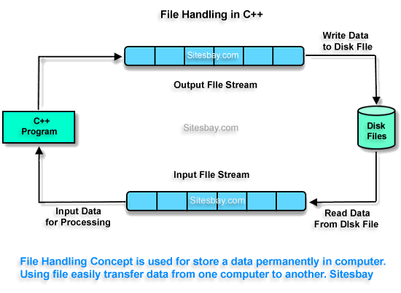
File Handling in C++
Can be created, updated, and processed by C/C++ programs
Are used for permanent storage of large amounts of data ( hard disk, …).
Storage of data in variables, arrays, and structures is only temporary
C++ views each file as a sequence of bytes
File ends with the end-of-file marker

Slide 11
Text File data types
For read and write from a file you need another standard C++ library called fstream, which defines three new data types:
Datatype | Description
ofstream | This is used to create a file and write data on files
ifstream | This is used to read data from files
fstream | This is used to both read and write data from/to files

Slide 12
How to achieve File Handling
For achieving file handling in C++ we need to follow the following steps
Naming a file
file-stream-class stream-object;
ofstream outfile; // output file
ifstream infile; // input file
Opening a file
outfile . open ("data1.txt"); // opening file for writing
infile . open ("data2.txt"); // opening file for reading
Reading data from a file or writing data into a file
int number;
outfile<<number;
infile>>number;
Closing a file
outfile.close();
infile.close();

Slide 13
Notes
There are a maximum number of files that can be open at any one time, so closing files when you are done with them is very important
We'll also see that stdin, stdout and stderr are special files which C/C++ opens automatically

Slide 14
Functions use in File Handling
Defining and Opening a File
The function open() can be used to open multiple files that use the same stream object.
Syntax
file-stream-class stream-object;
stream-object.open("filename");
Example
ofstream outfile; // create stream
outfile . open ("data1.txt"); // connect stream to data1
Function | Operation
open() | To create a file
close() | To close an existing file
get() | Read a single character from a file
put() | write a single character in file.
read() | Read data from file
write() | Write data into file.

Slide 15
Open the file
Before using a file stream, it must be associated to a real file for reading or writing or both. Associating a file stream to a file is accomplished by opening the file. Then any operation performed on this stream will be applied to the associated file. To open a file, we use the open method.
open (filename, mode); filename: a string representing the name of the file
mode: an optional parameter with a combination of the following flags
All these flags can be combined using the bitwise operator OR (|).
ios::in | Open for input operations.
ios::out | Open for output operations.
ios::binary | Open in binary mode.
ios::ate | Set the initial position at the end of the file. If this flag is not set, the initial position is the beginning of the file.
ios::app | All output operations are performed at the end of the file, appending the content to the current content of the file.
ios::trunc | If the file is opened for output operations and it already existed, its previous content is deleted and replaced by the new one.

Slide 16
Example:
ofstream myfile;
myfile.open ("example.bin", ios::out | ios::app );
If the file is opened without a second (mode) argument like:
ofstream myfile;
myfile.open ("example.txt" );
Then the default mode for each stream is applied:
ofstream ios::out
Ifstream ios::in
fstream ios::in | ios::out

Slide 17
To check if a file stream was successfully opened a file, use the is_open() method.
if (myfile.is_open()) {
// file is successfully opened, proceed
}
Example: open the file “student.txt” for reading
ofstream myFile("students.txt");
if ( !myFile.is_open()) {
cout << "Can't open the file student.txt \n");
}

Slide 18
The filename includes the full path, if the file is on desktop c:\Desktop\students.txt for writing
ofstream myFile("c:\\Desktop\\students.txt");
if ( !myFile.is_open()) {
cout << "Can't open the file student.txt \n");
}
open the file c:\\students.txt for appending
ofstream myFile("c:\\Desktop\\students.txt", ios::app );
if ( !myFile.is_open()) {
cout << "Can't open the file student.txt \n");
}

Slide 19
Example 1 : opening and closing a file
int main() {
fstream st; // Step 1: Creating object of fstream class
st.open("C:\\Users\\SD\\Desktop\\Text.txt", ios::in); // Step 2: Creating new file
if(!st) // Step 3: Checking whether file exist
{
cout<<"File creation failed";
}
else {
cout<<"New file created";
st.close(); // Step 4: Closing file
}
}

Slide 20
Example 2 : Reading numbers from a File
/* given int.txt file containing 10 numbers, read int.txt and add 20 to each integer, then write the modified integers into another file out.txt. */
#include<iostream>
#include<fstream>
using namespace std;
int main(){
ifstream in;
ofstream out;
in.open("numbers.txt");
out.open("updatedfile.txt");
if(!in.is_open() || !out.is_open()) { cout<<"opening failed"; return 0; }
int x;
while(in>>x){ x+=20; out<<x<<endl; }
in.close();
out.close();
}

Slide 21
Example 3 : Reading Employee’s information from a File
given emp.txt file that stores employees' information (includes name, id, # of hours of work and payment in $ / hour). Read the information from the file into a dynamic array of employees then compute the salary for each employee.
#include<iostream>
#include<fstream>
using namespace std;
struct emp{char name[100]; long id; int hour; int pay; };
int main(){
ifstream myfile;
myfile.open("emp.txt");
if (!myfile.is_open()){ cout << "error in opening file"; return 0; }
// to count number of records within the file
int count = 0 ; string line;
while(getline(myfile,line) ) count++;
emp*e=new emp[count];
// To reset the file pointer to the beginning of the file
myfile.clear(); // clear fail and eof bits
myfile.seekg(0);
for(int i=0;i<count;i++) myfile>>e[i].name>>e[i].id>>e[i].hour>>e[i].pay; // transferring data from file to the array e for processing
for(int i=0;i<count;i++) cout<<((e+i)->hour)*((e+i)->pay)<<endl; // printing the result on the screen
myfile.close(); //closing the file
}

